Slide 1


Dr. Diana Ruiz, DNP, RN, CNE, PHNA-BC, CCTM, CWOCN, NE-BC
A Snapshot of Children’s Development
in Ector County
Results from the 2018 Implementation of the
Early Development Instrument (EDI)

Slide 2
What is the EDI?

Slide 3

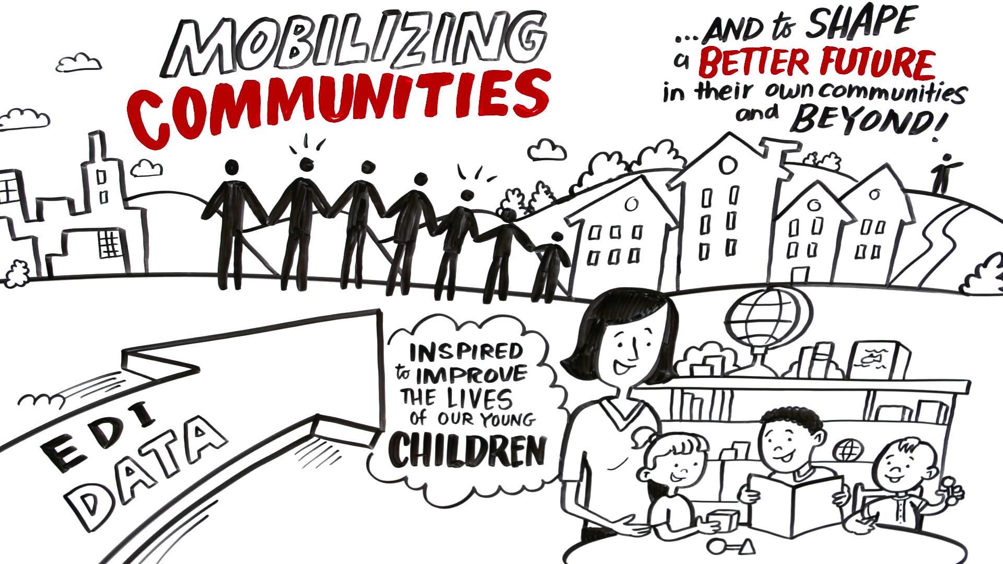
What is the EDI?
EDI and the Early Years
Notes:
The key purpose of the EDI is to provide
A community snapshot of children’s developmental outcomes
And to use this information to inform place-based planning and decision making that will improve and optimize healthy development for all children in the community
As a developmental snapshot taken during the kindergarten year, stakeholders use this information to both look back and to look forward
Cross sector early childhood collaborative use the EDI results to look back and reflect on how to better prepare children for school
School Districts and others use the data to look forward to anticipate how they can support this cohort of children as they progress in school

Slide 4

EDI Characteristic Highlights
Population focus
Community results reported by neighborhood geography
District receives confidential school level reports
Never reported by child or teacher
Holistic measure
Covers five developmental domains, 16 subdomains
Feasible to implement at scale
Collected once every 3 years by K teachers
User-friendly, online observational assessment, recall
Internationally validated
Developed at McMasters University, Canada
Successfully used in over 15 countries
National indicator in Australia
Strong reliability and validity
EDI Predicts later standardized test scores
Notes:
What makes the EDI an ideal tool for informing place-based efforts?
Population focus
It is designed to be collected on all children of kindergarten age in the community
Community results reported neighborhood by neighborhood
District receives confidential school level reports
Never reported by child or teacher
Holistic measure
Covers five developmental domains, 16 subdomains
Feasible to implement at scale
Collected once every 3 years by K teachers.
Teachers wait until at least 3 months into the school year
User-friendly, online observational assessment, recall
Teachers are an ideal group to collect these data .
Expertise and understanding of children.
Training can be standardized so data collected is accurate and consistent
The EDI research has found teachers provide valid and reliable data predictive of school success.
Internationally validated
The breadth of use and research was a key reason we chose to support the EDI in the US
The EDI was Developed in 1998 in Canada at McMasters University
Successfully used in over 15 countries
National indicator in Australia
There is almost 20 years of research now consistently showing good reliability and validity of the tool
The longitudinal studies are some of the most compelling
Showed that how children are doing developmentally, based on the EDI in kindergarten does predict later academic achievement as measured on standardized tests in 3-5th grade.
Children vulnerable on any one of the EDI scales in kindergarten are more likely to perform below expectation on all academic areas in grade 4 (D’angiulli, 2009)

Slide 5
EDI Results:
Which data were collected?
Notes:
for Children living in Ector County neighborhoods

Slide 6
Summary of EDI Participation
First Wave: 2013-14
Covered Ector County in the course of two years of data collection
Second Wave: 2018
Covered Ector County in one year of data collection
Geographic coverage of mapped data
96% geocoding rate of provided addresses
12 Neighborhoods in Ector County
All met inclusion criteria for reporting (more than 10 records)
11 met data stability threshold, with the last neighborhood just one record away from reaching the threshold

Slide 7
2018 EDI Data Collection
School Information
Participating school districts | 1
Participating schools | 25
Classrooms collecting EDI information | 94
Community Information
Children | 1,752
Children who are English Language Learners (ELL) | 22%
Children who have an Individualized Education Program (IEP) for children with disabilities | 8%
Race/Ethnicity:
African-American, Black | 3%
Asian, Native Hawaiian or other Pacific Islander | 1%
Hispanic, Latino/a | 77%
White | 17%
Other | 2%

Slide 8
What are children’s strengths
and challenges?

Slide 9
5 Developmental Domains
Communication Skills
Physical Health & Well-Being
Ability to use language
Communicate needs and understand
Motor skills
Physical readiness
Language &
Cognitive
Social Competence
Abilities with reading, writing, numbers, shapes
Getting along with peers,
Respect for others
Emotional Maturity
Emotional wellbeing, feeling sad, fearful, etc
Notes:
We'll be looking at children's development in Ector in the five developmental areas covered by the EDI
These are
Physical health: Motor skills, physical readiness
Social competence: Getting along with peers, respect for others
Emotional maturity: Emotional wellbeing, feeling sad, fearful, etc.
Language and cognitive: Abilities with reading, writing, numbers, shapes
Communication skills: Ability to use language, communicate needs and understand
The pie chart gives you a sense of the relative distribution of items in each of these domains.
There are 103 items used to score the domains
As the chart shows, over 50% of the items come from the social and emotional domains
This is extremely important because we know these areas of development are key to overall wellbeing and success in life and are sometimes left off in measures of school readiness.
Also, data results can also be broken out further into 16 subdomains to give a more granular look at how children are doing. If there is interest and time during the Q&A we can take a look at that.

Slide 10

EDI Measurement
Vulnerable | At-Risk | On Track
0 to ≤ 10th percentile | >10th to ≤ 25th percentile | >25th - 100th percentile
Most likely to experience problems later in school | Not vulnerable but lower than expected | Meets developmental milestones and expected to be successful in later grades
Notes:
One last bit of background….
When we report children’s developmental status on the EDI, we use the measures/terms vulnerable, at risk and on track.
Children are categorized this way based on how they score relative to national normative cutoffs.
We established the EDI normative cutoffs in 2009 with a sample of 10,000 children
Though we’ve added a lot of sites since that time and have quite a diverse set of urban and rural communities, the normative data have shifted only slightly and are also still very close to those in CAN and AUS.
As a result, we’ve kept the normative cutoffs the same so that communities doing the EDI over time have a stable benchmark to examine change over time.
Now let’s look at what these terms mean..
Vulnerable – A child is considered Vulnerable
If their EDI score is at or below the 10% percentile normative cutoff (see blue figure)
This translates to meaning that they are not meeting developmental milestones for this age and therefore are likely to experience problems later in school if no additional supports are provided.
At Risk – A child is at risk for becoming vulnerable if
They score between the 10th and 25th percentile cutoffs
They are not vulnerable yet but are lower than expected for this age and t risk for continuing on a lower achievement trajectory
On Track –
These are the children scoring above the 25th percentile cutoff
They are meeting developmental milestones and expected to be successful in later grades

Slide 11
School Snapshot

Slide 12
Comparison of EDI Results by Developmental Domain
National Convenience Sample (2017) vs. Ector County (2018)
Physical Health and Well-being
Social Competence
Emotional Maturity
Language and Cognitive Development
Communication Skills and General Knowledge
Distribution Across All Developmental Domains
Notes:
This graph is giving you a comparison of EDI results at the domain level for the communitywide results in Ector neighborhoods relative to our national averages.
Keep in mind that when I use the term communitywide or Ector County results, these are for all children living and attending school in Ector County (this includes a handful of kids who attend school in Midland, but live in Ector)
It shows the percent of children that are vulnerable, at risk and on track in each of the 5 domains
For instance, this first one is for Physical health
The top bar is Ector County and the bottom is nationally results
For Ector County, it shows that 10% of children are vulnerable, 13% are at risk and 77% are on track.
Ector County is on par with our national convenient sample. For instance, looking at the orange on track category, Ector County is doing the same as the national sample at 77% and the likewise in vulnerable and at risk
Let’s look at the rest of the domains – just the % on track and just for Ector County
Physical health is 77%
Social is 72%
Emotional 75%
Lang & Cog 73%
Communication skills 74%
Distribution across all domains – composite score
On track on all domains is at 50% compared to the national of 48%
The area where the EDI shows your children have the greatest developmental strength is in Physical Health & Well being at 77%
All the others are vary between 72&75%
Social Competence, at 72%, is your poorest outcome measure out of the 5 domains
Something else to take note of is Social Competence and Emotional Maturity domains stand out to me though because they have the biggest gap of children on track below the national convenient sample.
Emotional Maturity, where you have the biggest gap compared to the national convenient sample
So potentially the big picture message here is that the area
where children are doing the best is with Physical Health
and the area needing the most improvement is Social Competence and Emotional Maturity
We can learn from here is that Ector is doing slightly better than the national data. First thing these types of analyses tell us is that in order for us to plan improvement strategies, neighborhood level data are essential. Because at county-level, we’re masking all the variation that really layout geographies of risk and geographies of opportunity throughout Ector

Slide 13
Comparison of EDI Results by Developmental Domain
National Convenience Sample (2014) vs. Ector County (2014)
Physical Health and Well-being
Social Competence
Emotional Maturity
Language and Cognitive Development
Communication Skills and General Knowledge
Distribution Across All Developmental Domains
Notes:
This graph is giving you a comparison of EDI results at the domain level for the communitywide results in Ector neighborhoods relative to our national averages.
Keep in mind that when I use the term communitywide or Ector County results, these are for all children living and attending school in Ector County
It shows the percent of children that are vulnerable, at risk and on track in each of the 5 domains
For instance, this first one is for Physical health
The top bar is Ector County and the bottom is nationally results
For Ector County, it shows that 8% of children are vulnerable, 12% are at risk and 80% are on track.
Ector County is on par outperforming our national convenient sample. For instance, looking at the orange on track category, Ector County is doing better than the national sample at 76% and likewise in vulnerable and at risk
Let’s look at the rest of the domains – just the % on track and just for Ector County
Physical health is 77%
Social is 72%
Emotional 75%
Lang & Cog 73%
Communication skills 74%
Distribution across all domains – composite score
On track on all domains is at 50% compared to the national of 48%
The area where the EDI shows your children have the greatest developmental strength is in Physical Health & Well being at 77%
All the others are vary between 72&75%
Social Competence, at 72%, is your poorest outcome measure out of the 5 domains
Something else to take note of is Social Competence and Emotional Maturity domains stand out to me though because they have the biggest gap of children on track below the national convenient sample.
Emotional Maturity, where you have the biggest gap compared to the national convenient sample
So potentially the big picture message here is that the area
where children are doing the best is with Physical Health
and the area needing the most improvement is Social Competence and Emotional Maturity
We can learn from here is that Ector is doing slightly better than the national data. First thing these types of analyses tell us is that in order for us to plan improvement strategies, neighborhood level data are essential. Because at county-level, we’re masking all the variation that really layout geographies of risk and geographies of opportunity throughout Ector

Slide 14
16 Developmental Subdomains
Physical Health and Well-being
Physical readiness for school day
Physical independence
Gross and fine motor skills
Social Competence
Overall competence with peers
Respect and responsibility
Approaches to learning
Readiness to explore new things
Emotional Maturity
Prosocial and helping behavior
Anxious and fearful behavior
Aggressive behavior
Hyperactive and inattentive behavior
Language and Cognitive Development
Basic literacy skills
Interest in literacy/numeracy and memory
Advanced literacy skills
Basic numeracy skills
Communication Skills and Gen. Knowledge
Notes:
So part of what makes the EDI actionable is to first look at the domain level results (as we just did) and then to drill down into the subdomain level results
There are five domains and 16 subdomains.
All but one of the EDI domains have 3-4 subdomains.
There is only one domain that does not have subdomains is the Communication and general knowledge
Here is the list of domains by subdomain

Slide 15
EDI Measurement - Subdomains
Children categorized as either:
“not ready” for school
“somewhat ready” for school
“ready” for school
Criterion-referenced method
Different from norm-reference method used for domain-level results
Therefore, no one-to-one match between:
Percentages reported for sub-domain categories
Percentages reported for domain categories
Categories based on how child’s score compares to a criterion-referenced cutoff value
Scoring schema determined by publisher’s team of experts
“not ready”
“somewhat ready”
“ready”
“vulnerable”
“at risk”
“on track”
Notes:
For the sub-domain analysis, children are categorized as either “not ready,” “somewhat ready,” or “ready” for school
Based on how they compare to a criterion-referenced cutoff value that has been determined by the publisher’s team of experts at the Offord Centre
The criterion-referenced method for calculating sub-domain results is different from the norm-reference method used to calculate the domain level results
Therefore, there will not be a one-to-one match between any of the percentages reported in the sub-domain categories (“not ready,” “somewhat ready,” or “ready”) and the percentages reported in the domain level categories (“vulnerable,” “at risk,” and “on track”)
Normative cutoffs at 10%
At the start of the EDI project, clinical practitioners and developmental psychologists created a profile of a child that would be likely to experience challenges (ie vulnerable) as they entered kindergarten.
The profile included a range of age-appropriate indicators that reflected the development of the whole child: including such things as being able to hold a pencil, cooperate with their classmates, tell a short story of their day, or follow simple instructions.
Once the national pilot EDI data had been collected, analysis showed that, on each of the EDI scales, approximately 10% of the children fitted this profile. Using these data, the cut-off for each of the EDI scales was determined using the range of actual scores collected and setting the cut-off at the score that represented the lowest 10% of that range.

Slide 16
Physical readiness for school day
Over- or underdressed for school-related activities
Too tired/sick to do school work
Late
Hungry
Physical independence
Independent in bathroom habits most of the time
Shows an established hand preference
Well-coordinated
Sucks a thumb/finger
Gross and fine motor skills
Proficient at holding a pen, crayons, or a paintbrush
Ability to manipulate objects
Ability to climb stairs
Level of energy throughout the school day
Overall physical development
Notes:
Gross & fine motor skills have the smallest number of kindergartners ready

Slide 17
Overall competence with peers
Overall social/emotional development
Ability to get along with peers
Plays and works cooperatively with other children
Able to play with other children
Shows self-confidence
Respect and responsibility
Follows rules and instructions
Respects others’ property
Demonstrates self-control
Demonstrates respect for adults and other children
Takes responsibility for actions
Takes care of school materials
Shows tolerance to someone who made a mistake
Approaches to learning
Listens attentively
Follows directions
Completes work on time
Works independently
Works neatly and carefully
Able to solve day-to-day problems by him/herself
Follows one-step instructions
Able to follow class routines without reminders
Adjusts to changes in routines
Curious about the world
Eager to play with a new toy
Eager to play a new game
Eager to play with/read a new book
Readiness to explore new things
Notes:
Overall competence with peers has the lowest proportion of kindergartners ready

Slide 18
Prosocial and helping behavior
Tries to help someone hurt
Volunteers to help clear someone else’s mess
Comforts another upset child
Spontaneously helps to pick up objects another child has dropped
Invites bystanders to join a game
Helps others who are feeling sick
Anxious and fearful behavior
Is upset when left by a parent/guardian
Seems to be unhappy, sad, or depressed
Appears fearful or anxious
Appears worried
Cries a lot
Nervous, high-strung, or tense
Incapable of making decisions
Shy
Aggressive behavior
Gets into physical fights
Bullies or is mean to others
Kicks, bites, hits other children or adults
Takes things that do not belong to him/her
Laughs at other children’s discomfort
Disobedient
Has temper tantrums
Hyperactive and inattentive behavior
Can’t sit still, restless
Distractible, has trouble sticking to any activity
Fidgets
Impulsive, acts without thinking
Has difficulty awaiting turn in games or groups
Cannot settle into anything for more than a few moments
Inattentive
Will try to stop a quarrel
Offers to help others who have difficulty with a task
Notes:
Prosocial and helping behavior has smallest proportion of kindergartners not ready

Slide 19
What are the patterns of vulnerability across neighborhoods?
Notes:
Up until now, we’ve looked at the overall averages …
Now let’s begin to look at how this varies across census tracts to see what patterns emerge.
Other questions to keep in mind
Are the results matching what you would expect to see?
Are there any that don’t match?
What do you think is going on in these neighborhoods

Slide 20
Mapping the EDI
EDI Results
Measure of kindergarten-age children’s development, by neighborhood (CT)
Indicators and Assets
Community conditions and resources, by neighborhood (CT)

Slide 21
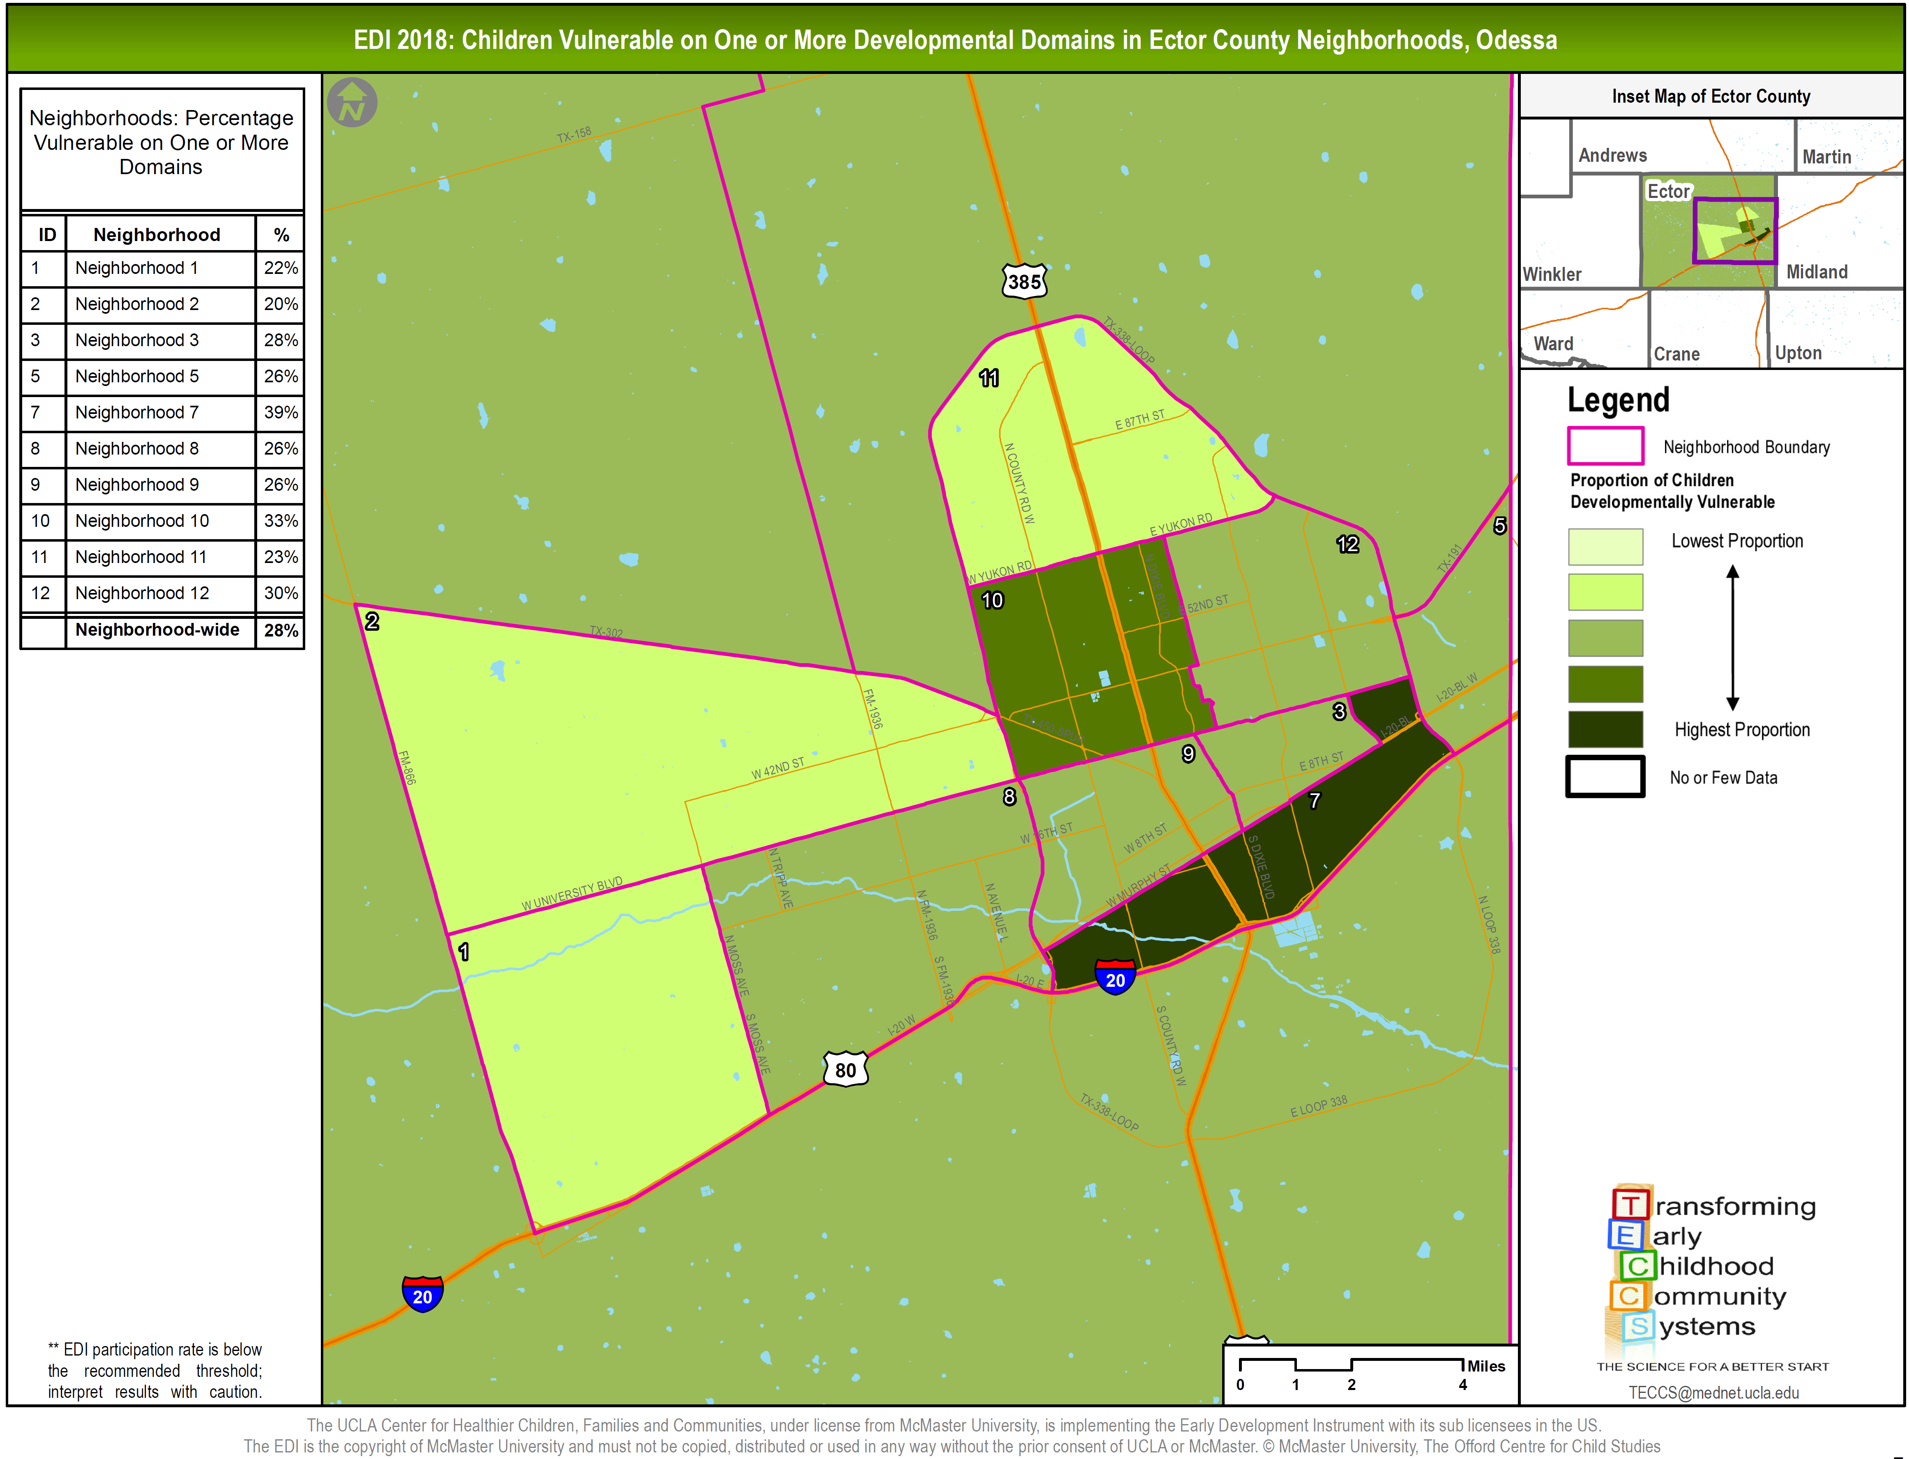

Slide 22
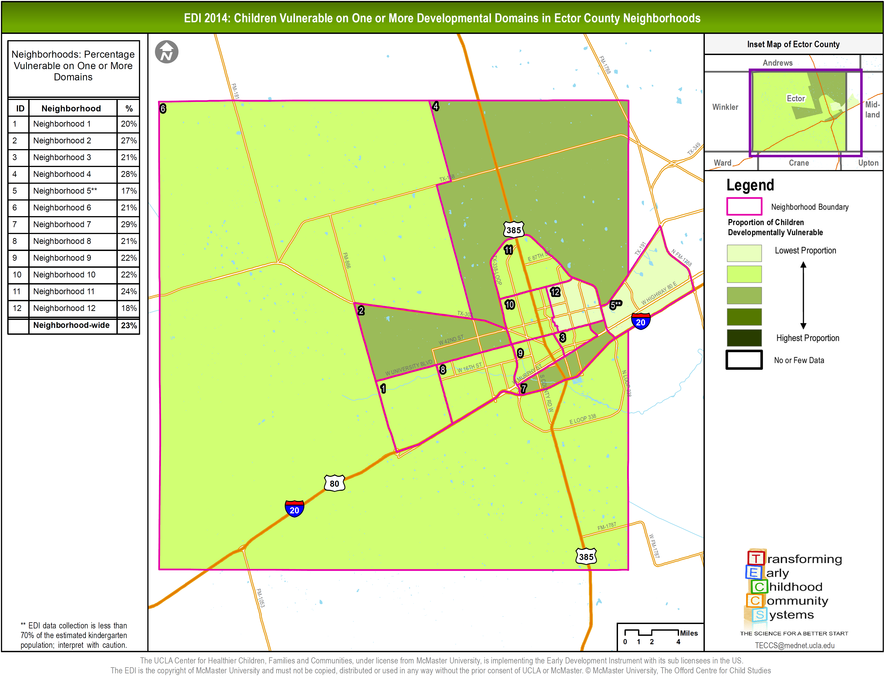
Notes:
All these variations get masked when you’re looking at county-wide data
½ standard deviations away from the mean
Using SDs (instead of quantiles) so we can look at change over time
Specifically, as nhoods improve (the degree of improvement would be consistent across the gradients)

Slide 25
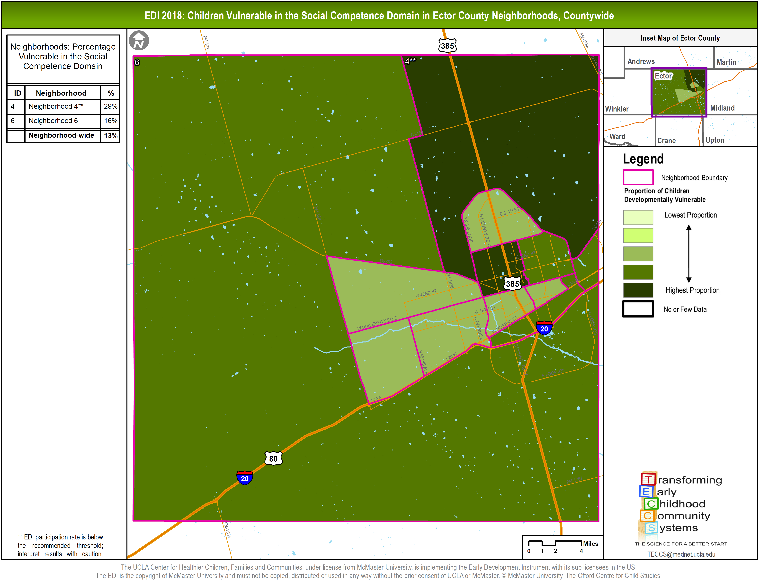
Notes:
Taking a look at neighborhood results in Social Competence, where we have the smallest proportion of children on track

Slide 26
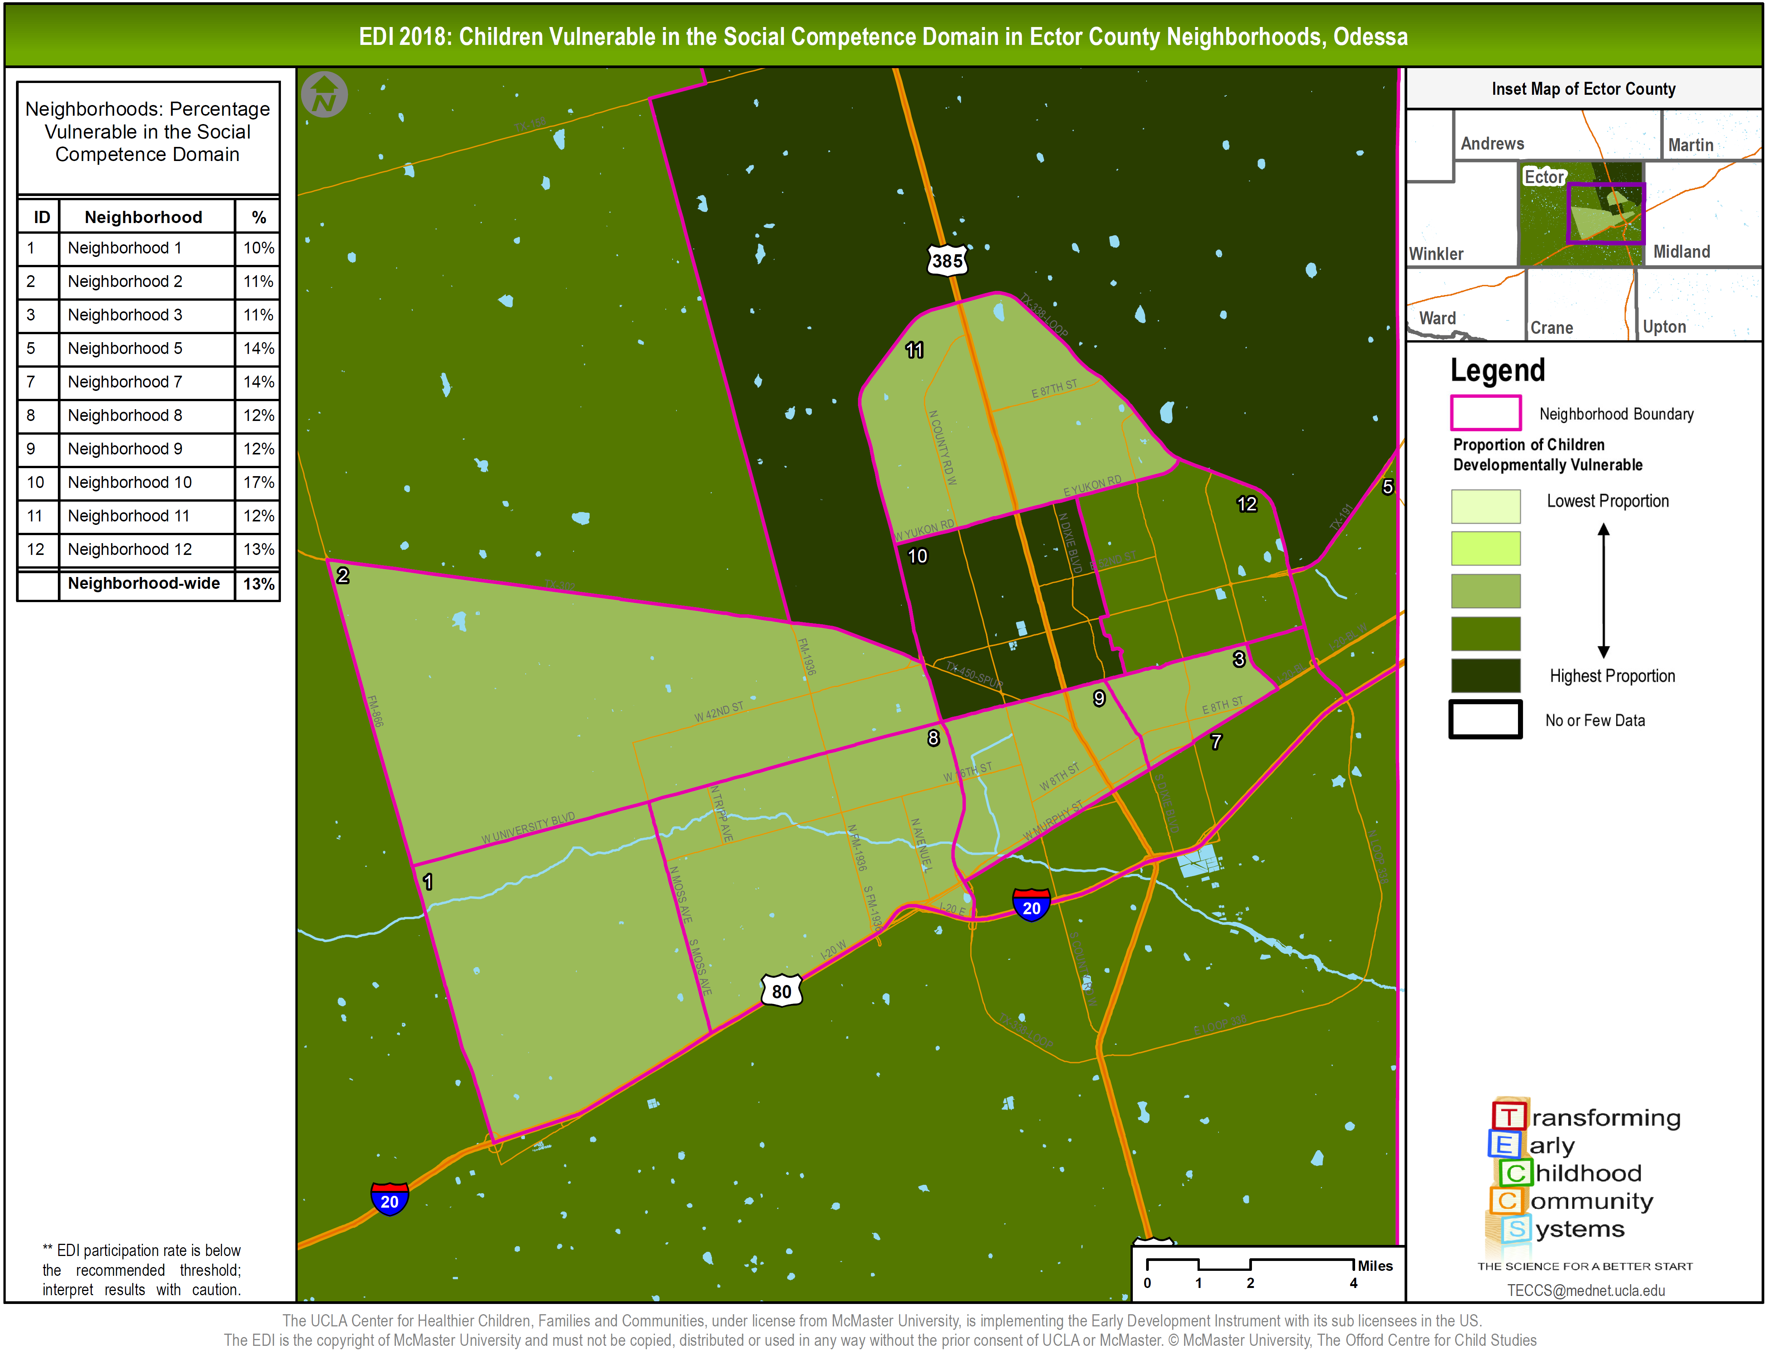

Slide 27
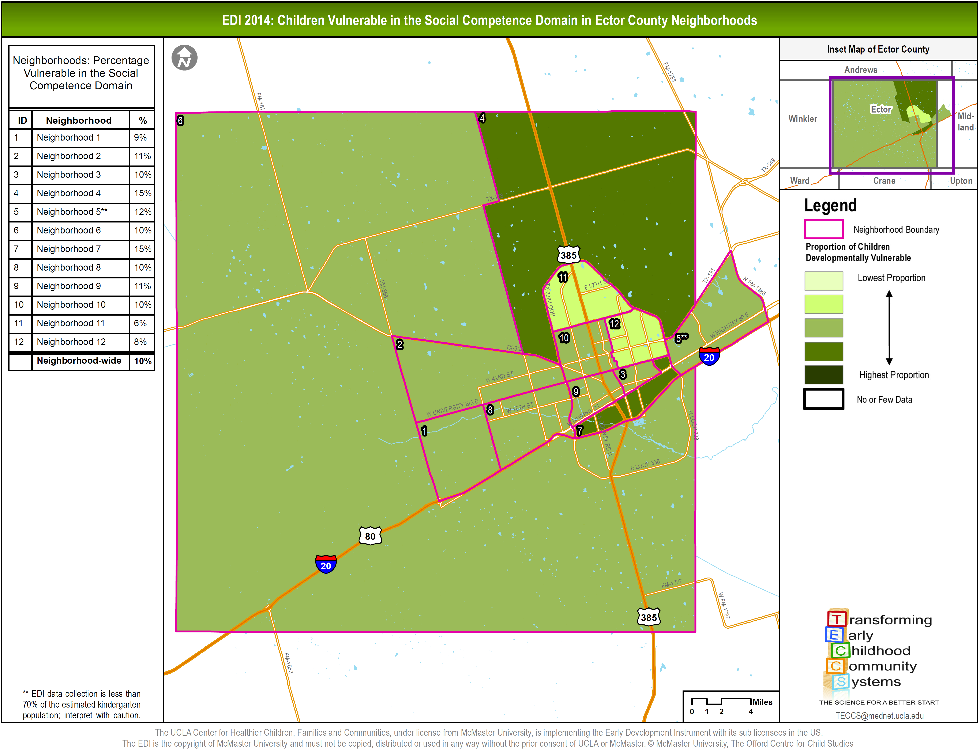
Notes:
Taking a look at neighborhood results in Social Competence, where we have the smallest proportion of children on track

Slide 28
Neighborhood Risk Index
A composite measurement of ten indicators of neighborhood level risk which can be associated with higher levels of developmental vulnerability in children
Ten variables taken for US Census American Community Survey
5 year estimates; 2012-2016
Compiled for all 70,000+ Census Tracts in US
Risk: +/- 1 standard deviation from national mean
Sign dependent upon if it’s a positive or negative indicator
Each Census Tract Categorized by Number of Risk Indicators present
Zero
Low – 1-2 Risk Indicators
Medium – 3-5 Risk Indicators
High – 6-10 Risk Indicators
Notes:
The NRI was developed by Dr. Charles Bruner and the Child and Family Policy Center
A national dataset was compiled containing all US census tracts for all ten indicators.
The risk threshold for each variable was defined as one standard deviation above or below the national mean, depending upon whether the indicator was positive or negative.
The total number of indicators meeting the risk threshold for each census tract was summed and categorized into four classes:
Zero (0 risk indicators),
Low (1-2),
Medium (3-5) and
High (6-10).

Slide 29
Ten Indicators of Neighborhood Risk
Positive Indicators (4)
% Population with a College Degree
(Ages 25 and Older)
% Population with Wage Income
% Owner-occupied Housing
% Households with Interest, Rent, or Dividend Income
Negative Indicators (6)
% Single Parent Family Households
% Limited English Speaking Households
% Disconnected Youth
(Ages 16-19; Unemployed and not in School)
% Population without a High School Diploma
(Ages 25 and Older)
% Families with Children in Poverty
% Households with Public Assistance Income

Slide 30
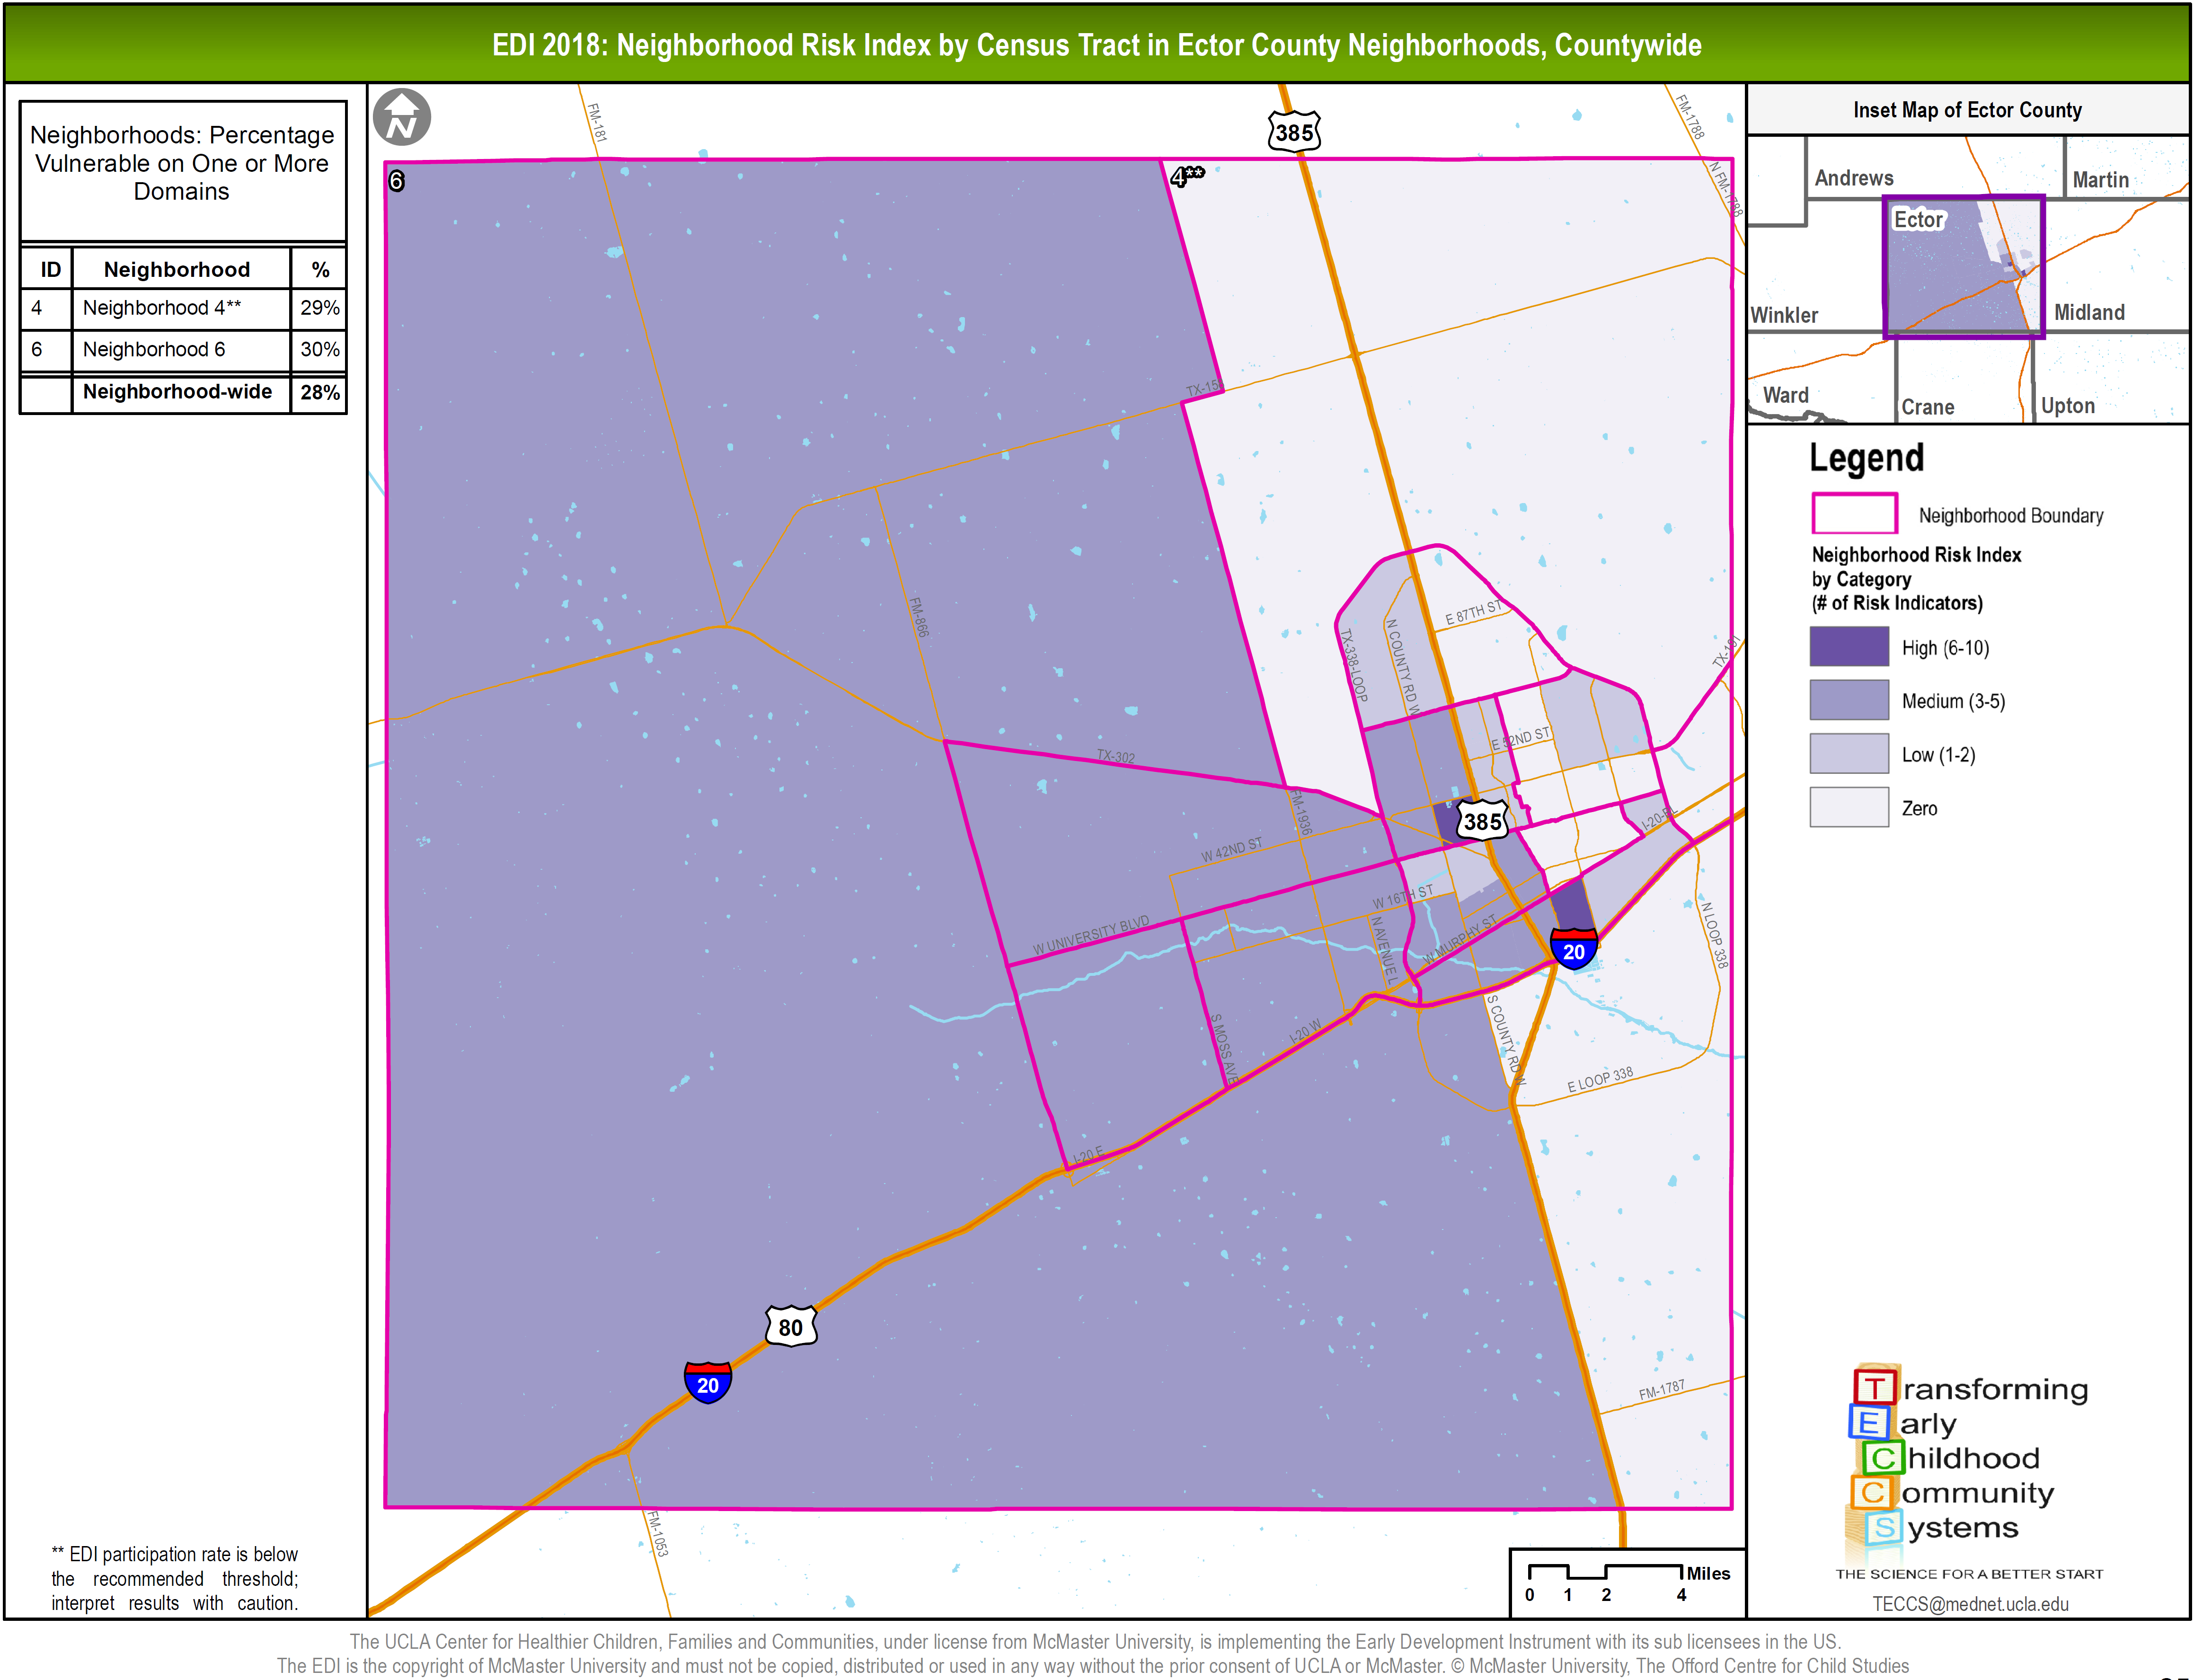
Notes:
In this map, we see the relative amount of risk (by Census Tract) within each of the neighborhoods. The darker the shade the more risk is experienced within that area.
Gives us some context of what’s happening in the neighborhoods that may be affecting family life and young children’s development

Slide 31
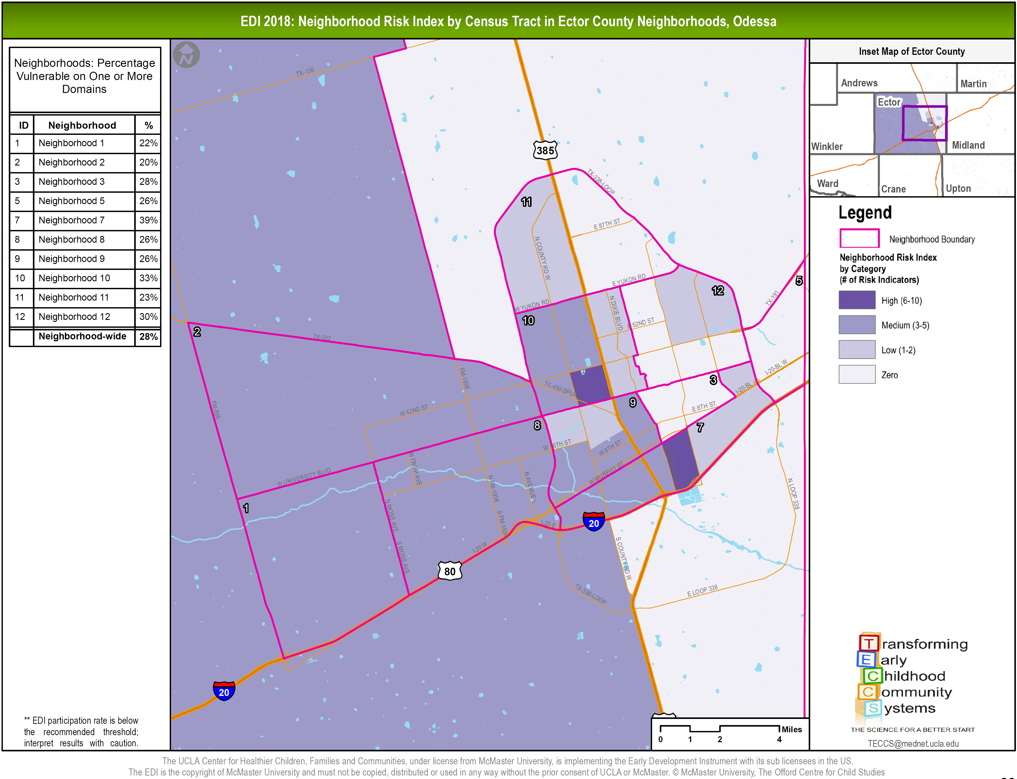

Slide 33
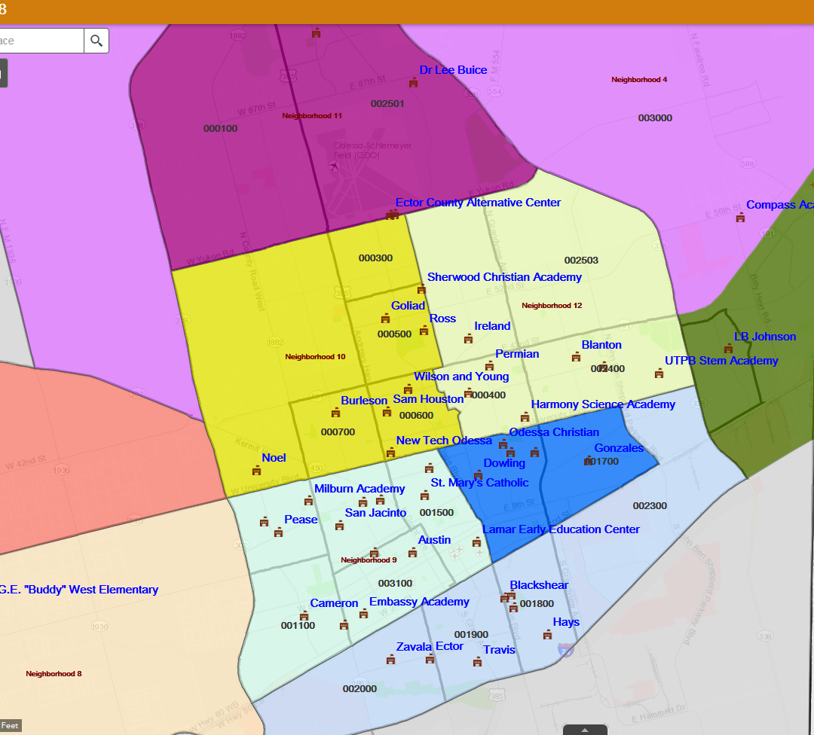

Slide 34
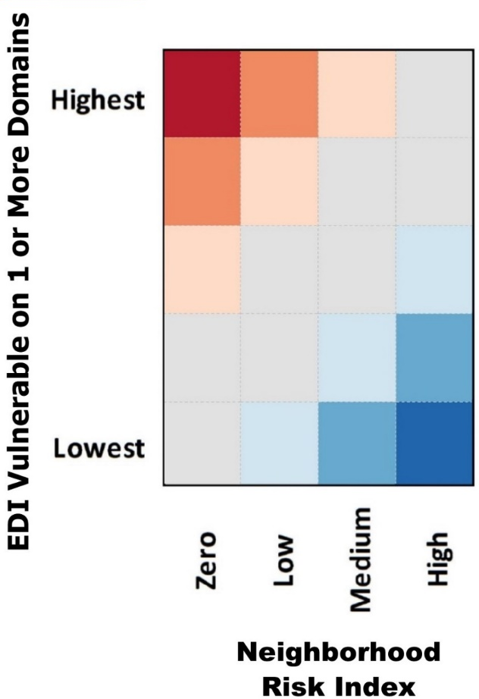
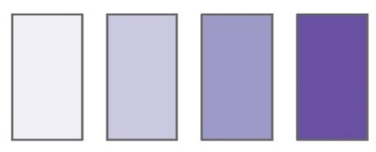
Comparing the Neighborhood Risk Index (NRI) to EDI Vulnerability
Use Vulnerable on 1 or More Domains Composite Measure
5 Mapped EDI Classes vs. 4 Neighborhood Risk Index Classes
Diagonal (Gray)
CTs that Generally Match
Off-diagonals
CTs with Mismatch
Red-High Vulnerability, Low Risk
Blue-Low Vulnerability, High Risk

Slide 35
